Slide 1
Multipath Fading
Name :- Anamika
Topic :- Multipath fading

Slide 2
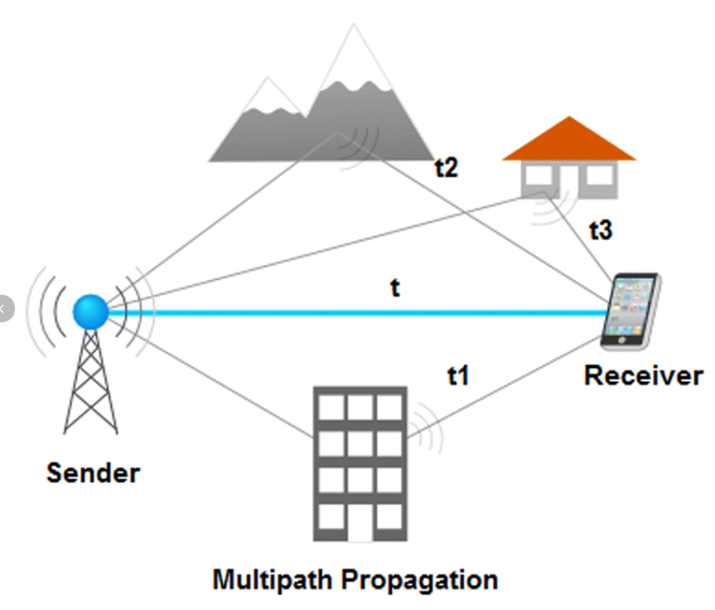
Multipath propagation
In multipath propagation radio signals reaching the receiving antenna by two or more path.

Slide 3
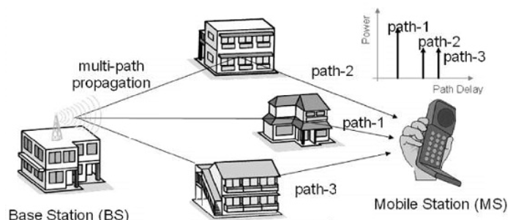
Multipath Fading
Multipath fading occurs when signals reach a receiver via many paths and their relative strengths and phases change.

Slide 4
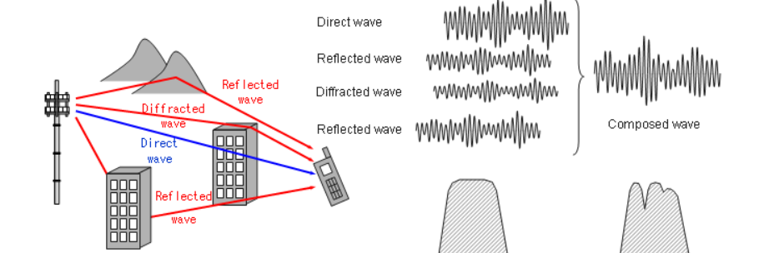
Causes of Multipath Fading
It includes atmospheric reflection and refraction, and reflection from water bodies and terrestrial objects such as mountains and buildings.

Slide 5
Effects of Multipath Fading
It include constructive and destructive interference, and phase shifting of the signal. In digital radio communications(such as GSM) multipath can cause errors and affects the quality of communications.
PARAMETERS OF MULTIPATH FADING
The fading may vary with time, geographical position and /or radio frequency, and is often modeled as a random process.

Slide 6
Types of Multipath Fading
Flat Fading: In flat fading, all frequency components get affected almost equally. Flat multipath fading causes the amplitude to fluctuate over a period of time.
Selective Fading: Selective Fading or Selective Frequency Fading refers to multipath fading when the selected frequency component of the signal is affected. It means selected frequencies will have increased error and attenuation as compared to other frequency components of the same signal. This can be overcome by techniques such as (OFDM )Orthogonal Frequency-division multiplexing which spreads the data across the frequency components of the signal to reduce data loss.

